Slide 1
Mobile Application Development - Day 7
Vector Drawable
Spinner

Slide 2
Vector Drawables OverView
a vector graphic defined in an XML file as a set of points, lines, and curves along with its associated color information.
Vector graphics are computer graphics images that are defined in terms of 2D points, which are connected by lines and curves to form polygons and other shapes - wikipedia
The major advantage of using a vector drawable is image scalability - the capacity to be changed in size or scale.
can be scaled without loss of display quality - means the same file is resized for different screen densities without loss of image quality - this results in smaller APK files and less developer maintenance

Slide 3
Vector Drawable
<path
android:fillColor="[your color (e.g. from resources or RGB Hex)]"
android:pathData="[SVG path commands]" />
We need the following SVG commands here:
M — absolute moveto
L — absolute lineto
z — closepath

Slide 4
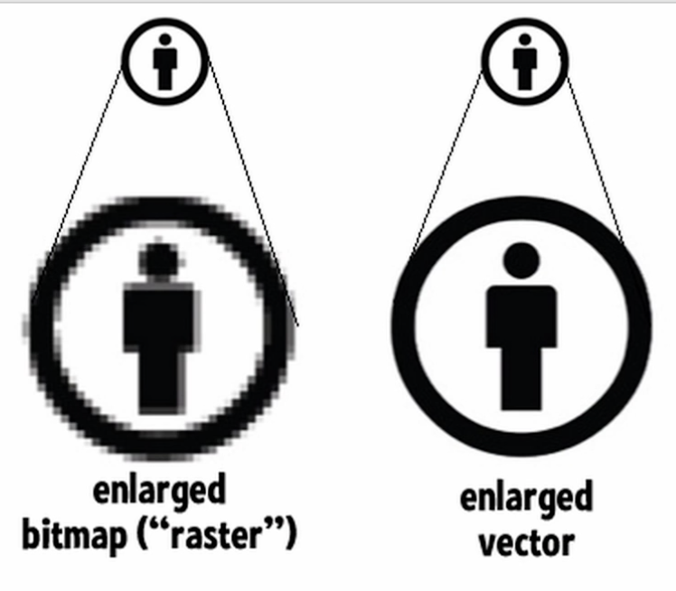
Vector Drawable
Raster images are composed of pixels
Vector images are composed of paths.

Slide 5
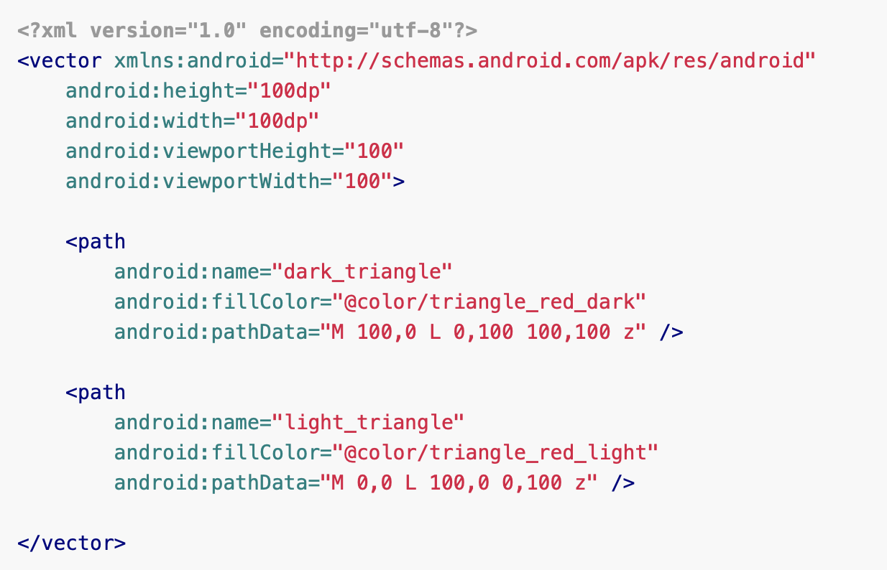
Vector Drawable
Sample

Slide 6
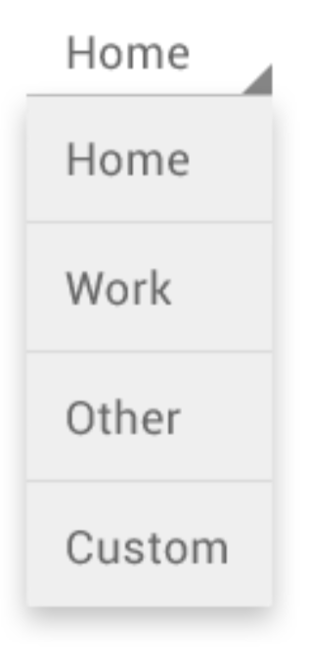
Spinner
Provide a quick way to select one value from a set
In the default state, it shows its currently selected value
<Spinner
android:id="@+id/planets_spinner"
android:layout_width="fill_parent"
android:layout_height="wrap_content" />
Key classes are the following:
Spinner - XML
SpinnerAdapter - Activity
AdapterView.OnItemSelectedListener - Activity

Slide 7
Spinner
To populate the spinner with a list of choices, specify a SpinnerAdapter in your Activity or Fragment source code.
The choices you provide for the spinner can come from any source, but must be provided through an SpinnerAdapter such as a
ArrayAdapter if the choices are available in an array
CursorAdapter if the choices are available from a database query.

Slide 8
Spinner -
<?xml version="1.0" encoding="utf-8"?>
<resources>
<string-array name="planets_array">
<item>Mercury</item>
<item>Venus</item>
<item>Earth</item>
<item>Mars</item>
<item>Jupiter</item>
<item>Saturn</item>
<item>Uranus</item>
<item>Neptune</item>
</string-array>
</resources>

Slide 9
Spinner
Spinner spinner = (Spinner) findViewById(R.id.spinner);
ArrayAdapter<CharSequence> adapter = ArrayAdapter.createFromResource(
this,
R.array.planets_array,
android.R.layout.simple_spinner_item);
adapter.setDropDownViewResource(android.R.layout.simple_spinner_dropdown_item);
spinner.setAdapter(adapter);

Slide 10
Adapter
Adapter takes data from data source
Eg of data source
Arraylist
Database
After taking data from data source it passes to adapter view
AdapterView displays data as we want

Slide 11
Sample Questions
How can we populate spinner with data? Write a program to populate spinner using data source from strings.xml . [10]
Write a program to draw triangle using vector. [5]
Explain vector drawables. [5]

